Slide 1
Computer Programming
Semester Project
Library Management System
Submitted by: Mubeen Ahmed Jawad (01-134182-081)
Submitted to: Sir Faisal Munir

Slide 2
Description
It is a console operated computer Program built using High level C++ language in Microsoft Visual Studio compiler using algorithm and various set of code.
It stores and lets you view large amounts of data and information like records of Books, students, faculty, suppliers for a library.
Purpose
Its main purpose is to help the administrator of a library in managing large amounts of book data in a very efficient and easy way. The admin can easily add records have manage them better.

Slide 3
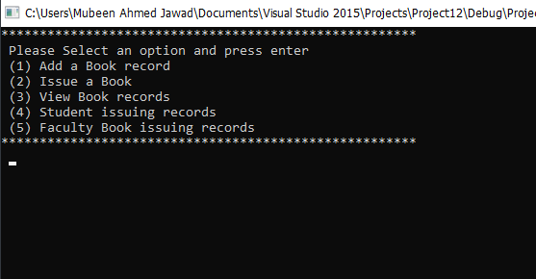

Slide 4
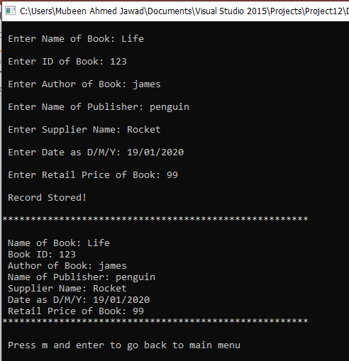

Slide 5
Advantages
Easy and efficient way to handle large amounts of data.
Saves a lot of time for the admin.
Any record can be easily searched or accessed at any time in case of any query.
Unlimited amounts of Data can be stored as long as the administrator system can handle it.
Issued books can be traced out easily in case of theft.

Slide 6
Thank You!

